Slide 1



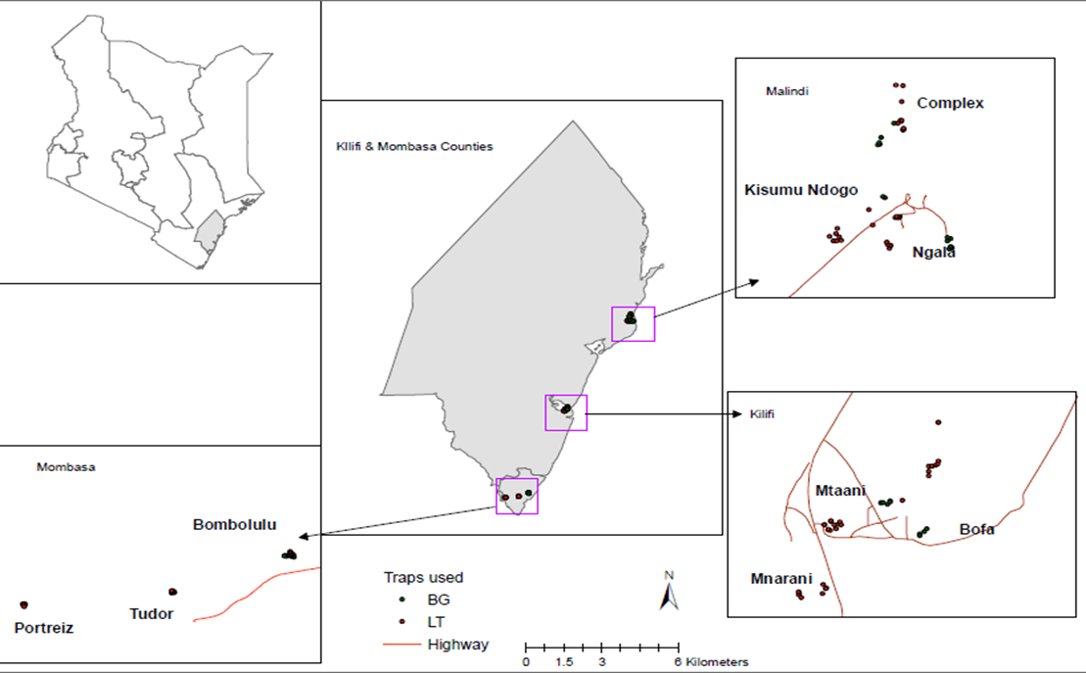
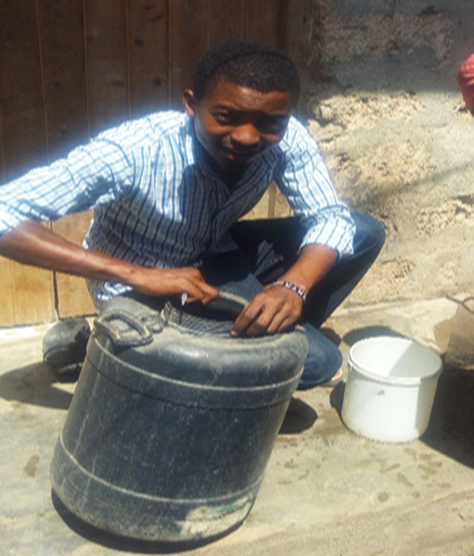
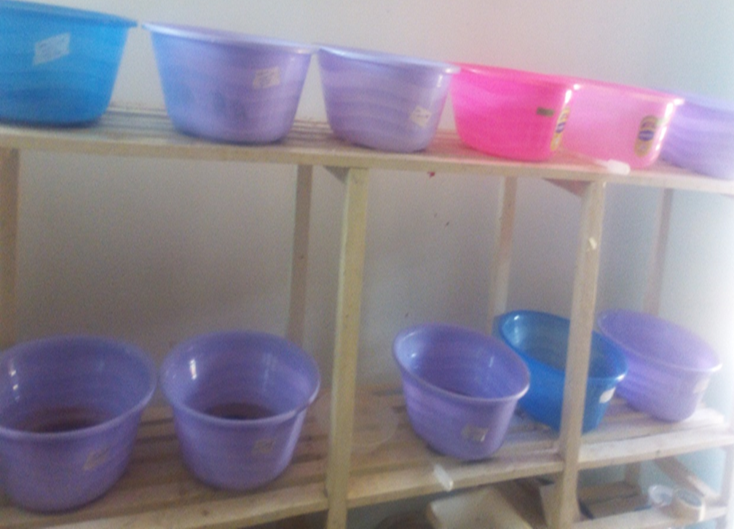
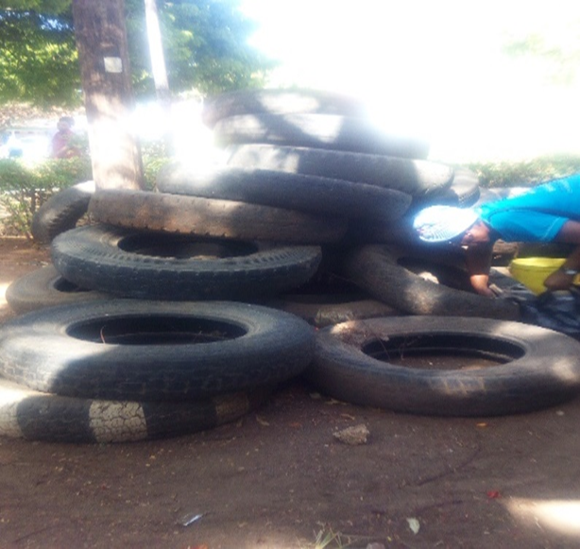
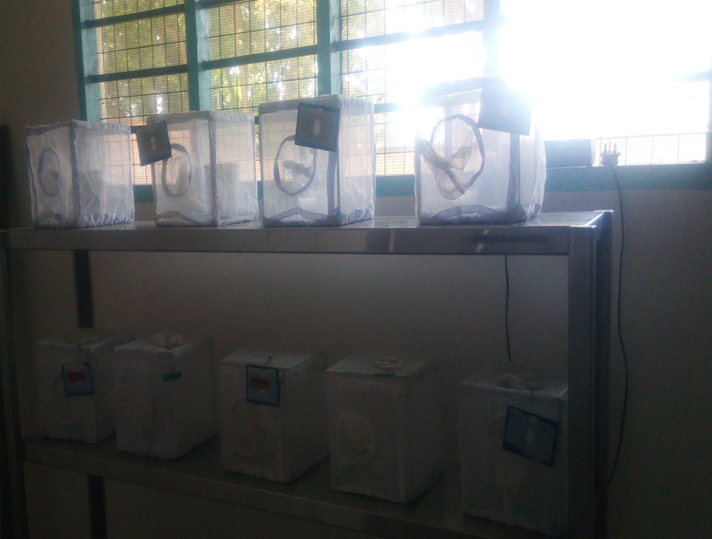
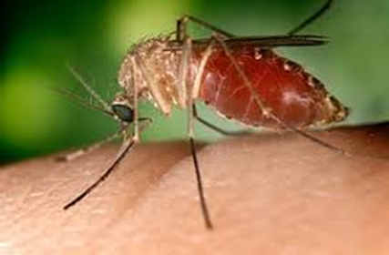
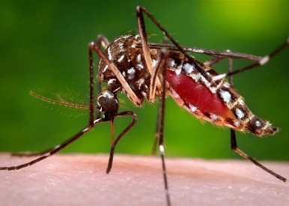
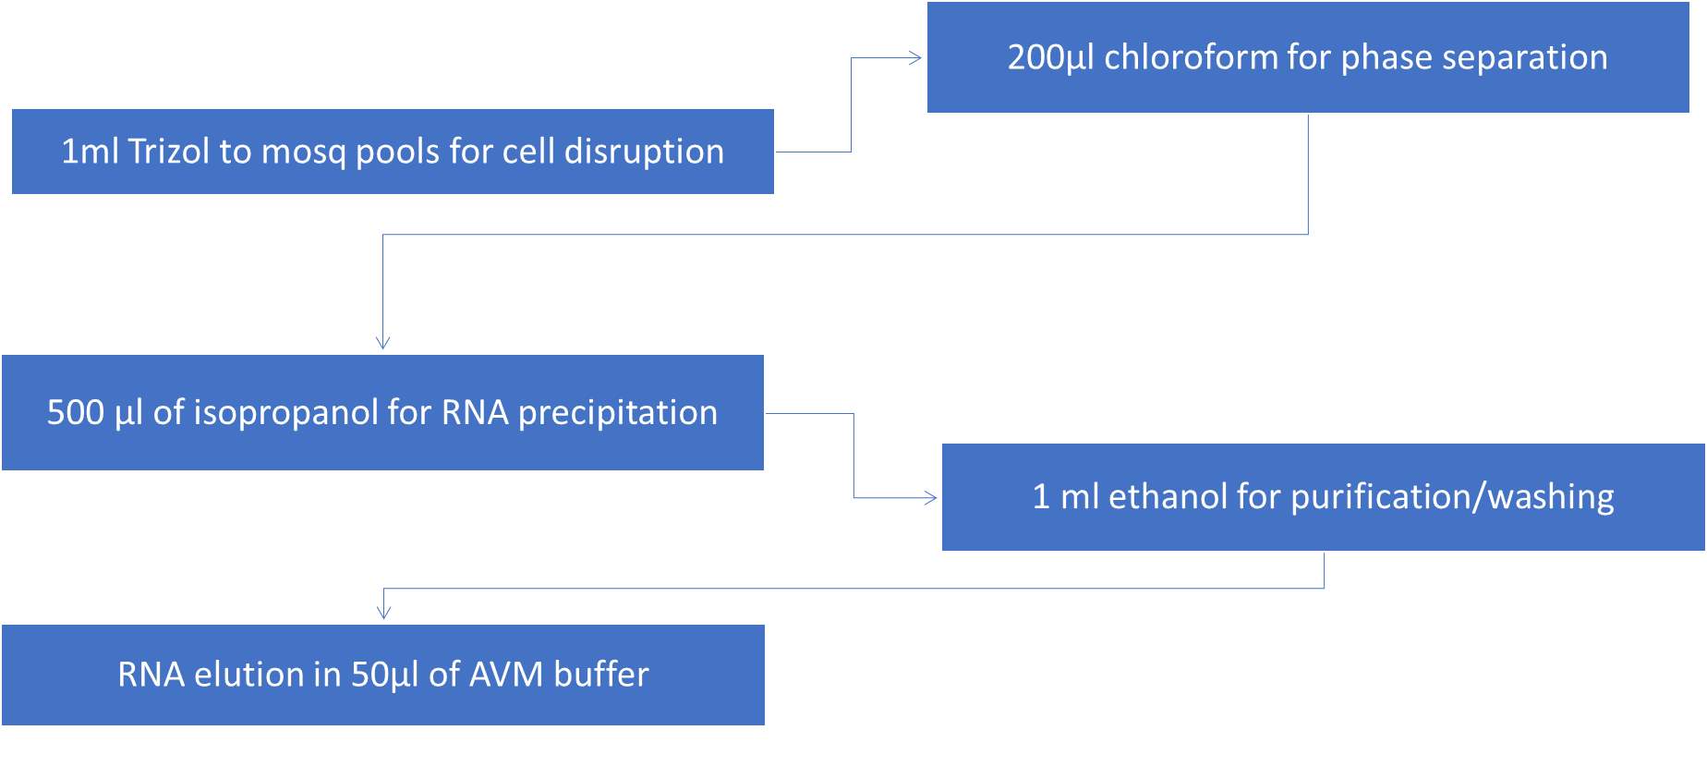
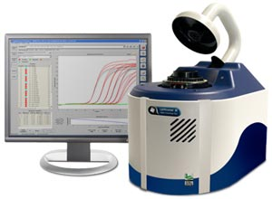
Urban ecology of arboviral mosquito vectors along the Kenyan coast
Jonathan Karisa, Simon Muriu, Donwilliams Omuoyo, Boniface Karia, Moses Ngari, Doris Nyamwaya, Martin Rono, George Warimwe, Joseph Mwangangi , Charles M. Mbogo
Introduction
Results
The emergence and re-emergence of arboviral infections particularly Chikungunya, dengue hemorrhagic fever, Rift Valley fever, and yellow fever in humans around the world threatens global health. The purpose of this study was to determine the urban ecology of the common arboviral mosquito vectors in urban Coastal Kenya areas
A total of 3,264 adult mosquitoes belonging to ten species of Culex (Cx.), Aedes (Ae) and Anopheles (An.) were collected. Overall, the predominant species were Cx. quinquefasciatus 72.4% (n=2,364) and Ae. aegypti, 25.7%, (n=838).
A total of 415 breeding habitat types were identified indoors (n=317) and outdoors (n=98). The most productive habitat types in both indoors and outdoors were: assorted small containers, water tanks, drainages, drums and jerricans.
Overall, 62% (n=18) of the soil samples collected from the two sites (Kilifi and Malindi) were positive for larvae which were used as proxy to measure the presence of eggs.
The mosquitoes had high preference for human blood (29.81%) and chicken (3.73%) but none had fed on either goat or bovine.
Of 259 mosquitoes tested for viral infection, 11.6% were positive for Flavivirus only
Methodology
Fig 1. Map showing the study area
Fig 2. Larval collection
Fig 3. Larval rearing-insectary
Fig 4. Soil sample collection
Fig 5. Adult rearing-insectary
Pooling
Site, method of collection, species, sex
Fig 6. Morphotyping using keys (Edwards, 1941 & Jupp, 1986)
Blood meal analysis was done using Enzyme Linked Immuno-Sorbent Assay (ELISA) method (Beier et al., 1988; Mwangangi et al., 2003)
Fig 7. RNA extraction and arboviral screening using RT-qPCR
Conclusion
Domestic and peri domestic containers were identified to be the key breeding areas of arboviral vectors. Efforts should be put in place targeting the productive habitat types

